Slide 1
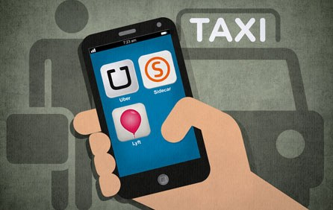
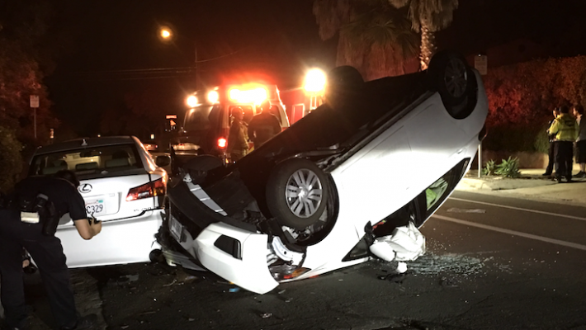
Do TNCs affect DUI Deaths?
By Drew Russell, Mayssa Maring, Aaron Kim

Slide 2
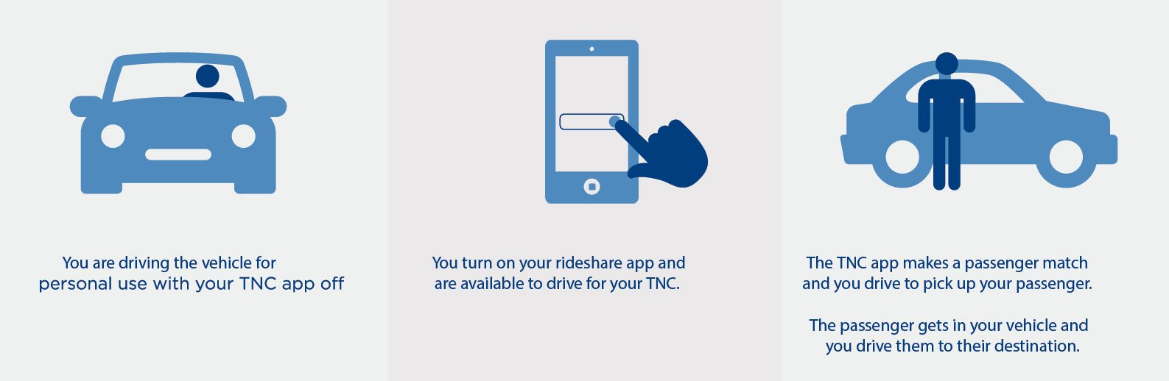

Transportation Network Company (TNC)
Also known as mobility service provider (MSP) or ride-hailing service
Defined as a company that uses an online-enabled platform to connect passengers with drivers using their personal, non-commercial vehicles
Provide service to areas that do not have taxis normally available
Charging lower rates than taxicabs

Slide 3
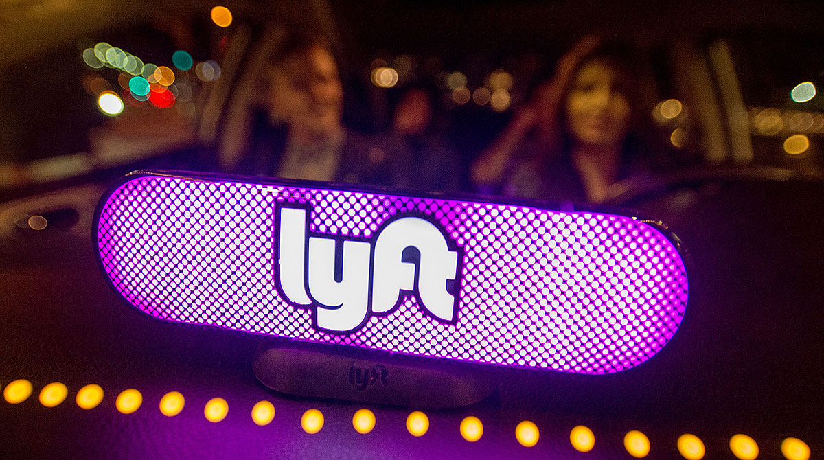
Lyft
Lyft was launched in 2012 in San Francisco by Logan Green and John Zimmer as a service of Zimride, a ridesharing company the two founded in 2007
By 2013, Lyft was providing 30,000 rides a week
August 2013, it hits a million completed rides.
April 2014, Lyft had become available in 60 U.S. cities.

Slide 4
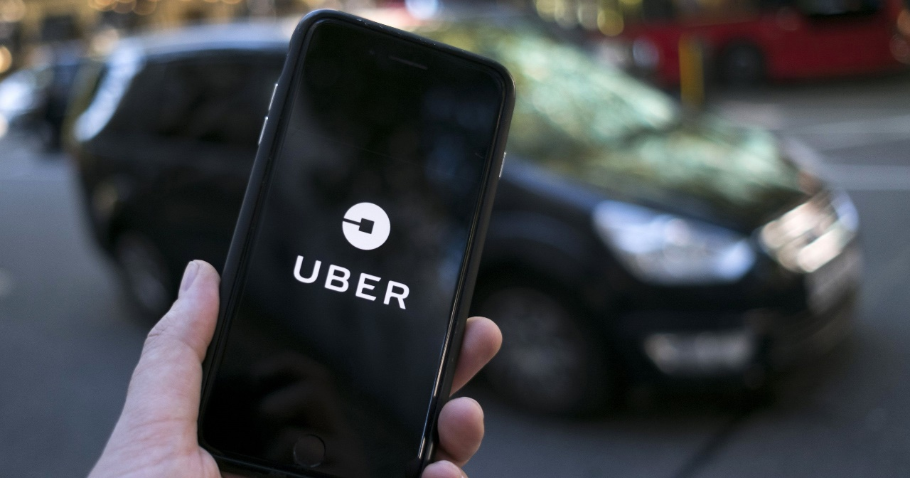
Uber
Uber was founded in 2009 as UberCab by Garrett Camp and Travis Kalanick
Other Uber ventures:
Self-driving technology
Uber Air
Uber Eats
UberGo, rides in a hatchback

Slide 5
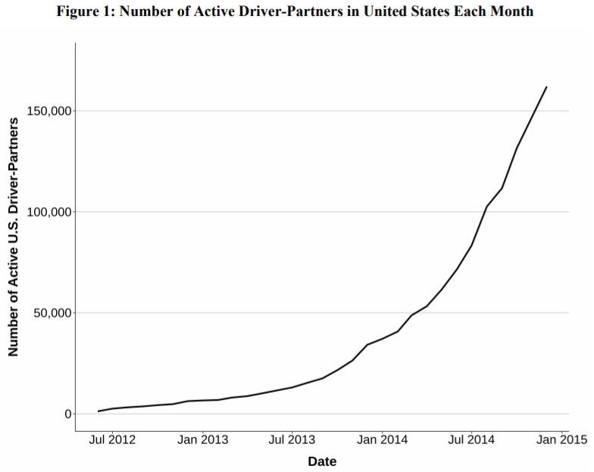
Uber
In July 2012, the company introduced UberX, using non-luxury vehicles
By early 2013, the service was operating in 35 cities as well as allowed drivers to use their personal vehicles
From a base of near zero in mid-2012, more than 160,000 drivers actively partnered with Uber at the end of 2014 in the United States

Slide 6
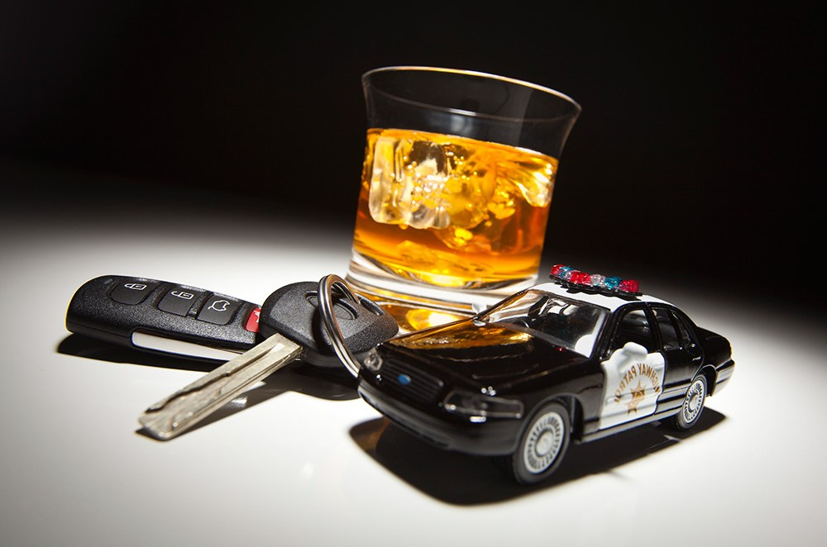
DUI
Driving under the influence (DUI) occurs when a person operates a motor vehicle while intoxicated
Minors - blood alcohol levels of 0.01 or higher
CDL license holders - blood alcohol levels of 0.04 or higher.
The highest percentage of drunk drivers were 21- to 24-year-olds, at 27 percent, followed by 25- to 34-year-olds, at 26 percent.
Men are most likely to be involved in this type of crash, with 4 male drunk drivers for every female drunk driver.

Slide 10
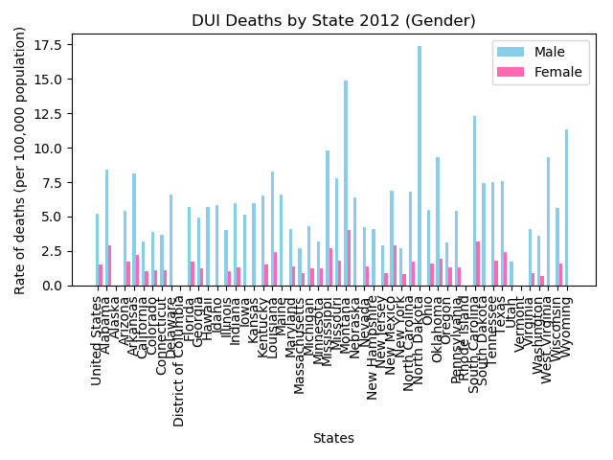

Slide 11
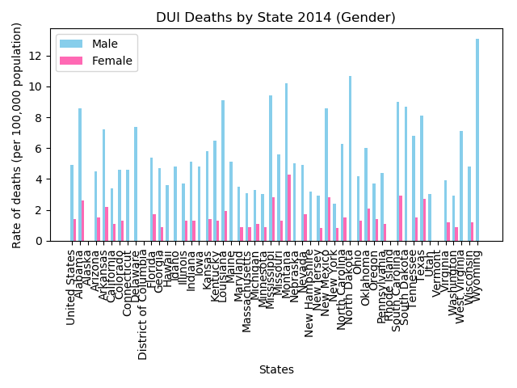

Slide 12
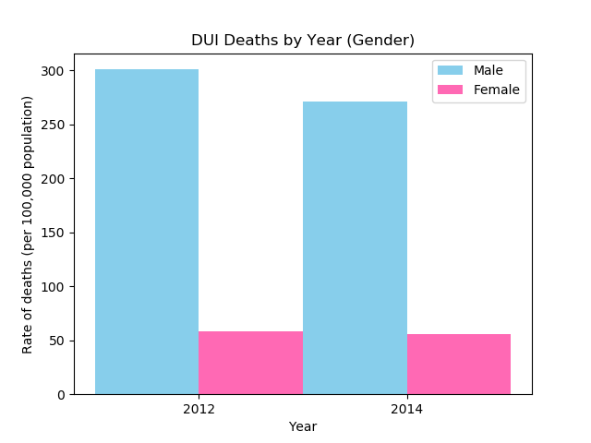

Slide 13
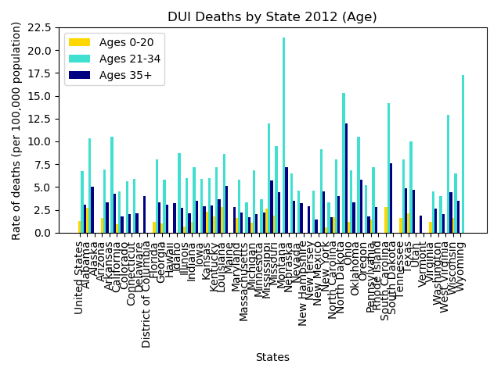

Slide 15
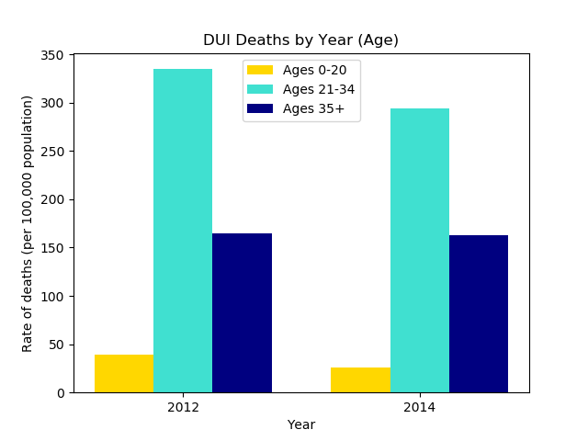

Slide 17
References
https://en.wikipedia.org/wiki/Uber
https://www.uber.com/blog/los-angeles/uber-la-officially-launched/
https://s3.amazonaws.com/uber-static/comms/PDF/Uber_Driver-Partners_Hall_Kreuger_2015.pdf
https://en.wikipedia.org/wiki/Transportation_network_company
https://en.wikipedia.org/wiki/DUI_laws_in_California
https://www.nhtsa.gov/risky-driving/drunk-driving#age-5056
https://mrcheckpoint.com/can-i-get-a-dui-removed-from-my-record-in-california/
https://www.edhat.com/news/dui-suspected-in-rollover-accident
https://catalog.data.gov/dataset/impaired-driving-death-rate-by-age-and-gender-2012-all-states-587fd

